Slide 1
WEEK 3

Slide 2
Wireless connectivity/communication
If a underwater robot, wants to send you the data or vice versa, wired communication falls short

Slide 3
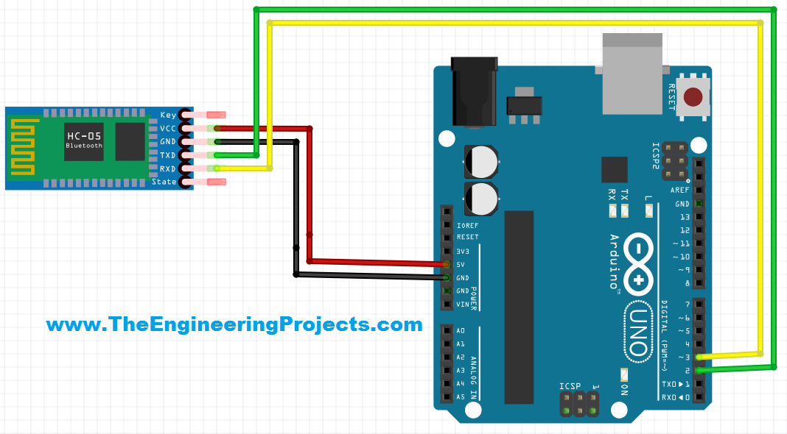
HC-05
HC-05 is a low cost bluetooth module.

Slide 4
Software Serial
Don't you think, just 1 receiver and 1 transmitter pin is too less for a complex project?
using software serial, any digital pin can be used as communication pins.
Software Serial is exactly same as Serial, all functions like println,available etc hold good.
References - here

Slide 5
TASK
to make a voice controlled robot, controlled from android smartphone via bluetooth
Reference - here
Go through the reference, you can control anything, but lay emphasis on receiving data.

